Slide 1
Local Government Pension Schemes
Investing members’ money in death, destruction and climate catastrophe

Slide 2




Background to LGPS
SCHEME FOR LOCAL GOVT EMPLOYEES +
FULLY FUNDED SCHEME (CONTRIBUTIONS + INVESTMENTS)
TOTAL VALUE OF £391.5 BN
6.7 MILLION MEMBERS

Slide 3
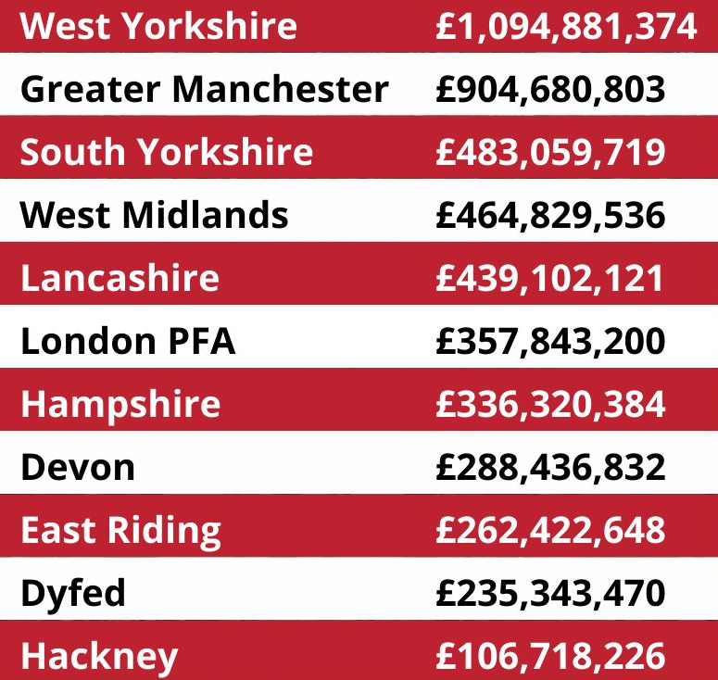
National picture
Top 10 LGPS investors in Israeli genocide and apartheid
(source and image: PSC)

Slide 4
Divestment “successes”
July ’24 | Waltham Forest, Islington
Sept ’24 | Lewisham
Nov ‘24 | Manchester, Trafford
Jan ’25 | Bristol, Tower Hamlets
Feb ’25 | Sheffield, North Somerset

Slide 5
SYPA
179 903 scheme members
Assets of c.£11bn
130-150% funded
c.£255.7m investment in fossil fuels (2.3% of total fund)
c.£108m investments in defence companies (1% of total fund)
£4.8m invested in Israel (0.04% of fund), incl. £1.4 in govt bonds
Investments in Israel, defence and fossil fuels total just 3.3% of fund

Slide 6
Green Group divestment motion
5th Feb 2025
Called for SYPA to divest from weapons companies, fossil fuels and Israeli gov’t bonds
Called for SCC ethical procurement policy to prevent contracts with companies (e.g. Barclays)
Called for end of government military support for Israel
Supported by campaigners who wrote hundreds(?) of emails to Councillors

Slide 7
Highlighted amendments/deletions by Labour and Lib Dems:
"Opposing Sheffield Council Taxpayers Investments In Israel, Weapons Manufacturing and Fossil Fuels" “Ethical Investment of Pension Funds” - (new title added by Labour)
(h) that over 46,000 people in Gaza, including 14,000 children, have been killed by Israel, and 90% of homes have been destroyed, with the help of UK-made weapons; (deleted by Labour)
(f) that the South Yorkshire Pensions Authority (SYPA) maintains investments in Israel, weapons manufacturing companies, and fossil fuel companies, and believes this contradicts its Responsible Investment policy principle to “do no harm”; (deleted - Labour abstention, Lib Dem against)

Slide 8
(j) the UK Government’s military co-operation with Israel means it risks being complicit in war crimes, including genocide; (deleted - Labour against, Lib Dem against)
(k) stemming from obligations laid out by the ICJ, councils and Local Government Pension Schemes (LGPS) must avoid procuring from or investing the funds they manage, in companies that facilitate Israel's breaches of international law, including arms companies producing weapons used by Israel, companies conducting business activities in the occupied territories, and financial institutions which finance these companies; (deleted - Labour abstention, Lib Dem against)

Slide 9
resolves to:
(l) demand the Government ends all arms trade with Israel; stops supporting its military campaigns in Palestine, Lebanon and Syria; and supports accountability at the ICJ and ICC; (deleted - Labour abstention, Lib Dem against)

Slide 10
(m) call on SYPA and the Border to Coast pension pool to oppose investments in Israel, arms companies and fossil fuel companies and for them to:-
(i) amend their Responsible Investment policies to add exclusions and a policy of divestment from states and companies committing or profiting from human rights abuses and breaches of international law;
(ii) clearly publish holdings in states involved in human rights abuses, companies which manufacture weapons, and companies which produce fossil fuels; and
(iii) conduct rigorous due diligence to ensure that its funds are not being invested to profit from human rights abuses or war crimes; (deleted - Labour against, Lib Dem against)

Slide 11
(o) ask the Finance and Performance Policy Committee to ensure that this Council’s Ethical Procurement policy is robust to prevent contracts being awarded to companies which finance states in breach of ICJ rulings, arms companies and fossil fuels.(deleted - Labour abstention, Lib Dem against)

Slide 12
Green Group motion to Sheffield Council 5th Feb ’25: "Opposing Sheffield Council Taxpayers Investments In Israel, Weapons Manufacturing and Fossil Fuels"
That this Council:-
(a) welcomes the ceasefire in Gaza but condemns Israel’s mass killing of civilians up until implementation of the deal;
notes:
(b) that over 46,000 people in Gaza, including 14,000 children, have been killed by Israel, and 90% of homes have been destroyed, with the help of UK-made weapons;
(c) the body of evidence and reports, including by Al Haq, Amnesty International, the UN, Human Rights Watch and Médecins Sans Frontières, saying Israel’s actions have been consistent with genocide;
(d) the International Criminal Court (ICC) arrest warrant for the Israeli Prime Minister;
(e) the International Court of Justice (ICJ) ruling that Israel must end its occupation of Palestinian territory immediately;
(f) that the South Yorkshire Pensions Authority (SYPA) maintains investments in Israel, weapons manufacturing companies, and fossil fuel companies, and believes this contradicts its Responsible Investment policy principle to “do no harm”;
(g) Sheffield residents campaigning for the Council and SYPA to end contracts and investments in Israel, weapons manufacturers and fossil fuel companies profiting from conflict;

Slide 13
Green Group motion to Sheffield Council 5th Feb ’25: "Opposing Sheffield Council Taxpayers Investments In Israel, Weapons Manufacturing and Fossil Fuels"
believes:
(h) that war crimes must be investigated and perpetrators brought to justice;
(i) that only justice, equality and an end to occupation can bring peace;
(j) the UK Government’s military co-operation with Israel means it risks being complicit in war crimes, including genocide;
(k) stemming from obligations laid out by the ICJ, councils and Local Government Pension Schemes (LGPS) must avoid procuring from or investing the funds they manage, in companies that facilitate Israel's breaches of international law, including arms companies producing weapons used by Israel, companies conducting business activities in the occupied territories, and financial institutions which finance these companies;

Slide 14
Green Group motion to Sheffield Council 5th Feb ’25: "Opposing Sheffield Council Taxpayers Investments In Israel, Weapons Manufacturing and Fossil Fuels"
resolves to:
(l) demand the Government ends all arms trade with Israel; stops supporting its military campaigns in Palestine, Lebanon and Syria; and supports accountability at the ICJ and ICC;
(m) call on SYPA and the Border to Coast pension pool to oppose investments in Israel, arms companies and fossil fuel companies and for them to:-
  (i) amend their Responsible Investment policies to add exclusions and a policy of divestment from states and companies committing or profiting from human rights abuses and breaches of international law;
  (ii) clearly publish holdings in states involved in human rights abuses, companies which manufacture weapons, and companies which produce fossil fuels; and
  (iii) conduct rigorous due diligence to ensure that its funds are not being invested to profit from human rights abuses or war crimes;
(n) ask the Chief Executive to forward a copy of this motion to the SYPA and Border to Coast Pensions Partnership; and
(o) ask the Finance and Performance Policy Committee to ensure that this Council’s Ethical Procurement policy is robust to prevent contracts being awarded to companies which finance states in breach of ICJ rulings, arms companies and fossil fuels

Slide 15
Sheffield Council resolution 5th Feb ’25: “Ethical Investment of Pension Funds"
That this Council:-
(a) notes that all Sheffield City Councillors have consistently condemned the attacks on, and displacement of, Palestinian civilians;
(b) believes the ceasefire now needs to be the path to lasting peace and a two-state solution with viable and secure Palestinian and Israeli states;
(c) supports the action taken by the Government to review arms exports and to suspend sales that could be used to breach international law, and urges a thorough assessment of all remaining licenses and the suspension of any that run that risk;
(d) notes the Council’s actions to show solidarity with the Palestinian people, including:-
calling for an immediate ceasefire in November 2023;
reaffirming our recognition of Palestine as a sovereign state;
signing a friendship agreement with Nablus, West Bank, and looks forward to welcoming a delegation from Nablus this month to deepen our ties and friendship;
and flying the Palestinian flag on the UN Day of Solidarity;

Slide 16
Sheffield Council resolution 5th Feb ’25: “Ethical Investment of Pension Funds"
(e) notes the Council’s ongoing work to review its ethical procurement policy to prioritise social, climate and international justice;
(f) believes that pension investment should be made ethically, notes that the South Yorkshire Pensions Authority (SYPA) considers environmental, social and governance issues as part of their investment decision making process, and encourages all members of SYPA Board to continue using their positions to ensure pensions investments are made responsibly
(g) welcomes the ceasefire in Gaza but condemns Israel’s mass killing of civilians up until implementation of the deal;

Slide 17
Sheffield Council resolution 5th Feb ’25: “Ethical Investment of Pension Funds"
notes:
(h) that over 46,000 people in Gaza, including 14,000 children, have been killed by Israel, and 90% of homes have been destroyed;
(i) the body of evidence and reports, including by Al Haq, Amnesty International, the UN, Human Rights Watch and Médecins Sans Frontières, saying Israel’s actions have been consistent with genocide;
(j) the International Criminal Court (ICC) arrest warrant for the Israeli Prime Minister;
(k) the International Court of Justice (ICJ) ruling that Israel must end its occupation of Palestinian territory immediately;
(l) Sheffield residents campaigning for the Council and SYPA to end contracts and investments in Israel, weapons manufacturers and fossil fuel companies profiting from conflict;

Slide 18
Sheffield Council resolution 5th Feb ’25: “Ethical Investment of Pension Funds"
That this Council:-
believes:
(m) that war crimes must be investigated and perpetrators brought to justice;
(n) that only justice, equality and an end to occupation can bring peace;
(o) all states should be compliant with international law and the rulings of the ICJ and act to prevent war crimes; and
resolves to:
(p) ask the Chief Executive to forward a copy of this motion to the SYPA and Border to Coast Pensions Partnership.

Slide 19
Results arising from motion
Sheffield Council calls for ethical investment of pension funds for first time
Barclays/ethical procurement (March Finance cttee)

Slide 20
Sheffield Labour vs other Labour Groups
Other Labour groups support divestment (Bristol, Trafford, Manchester, North Somerset etc…) Sheffield Labour don’t
Sheffield Labour Group fake press release claiming their support for BDS printed in Morning Star and Sheffield Tribune

Slide 21
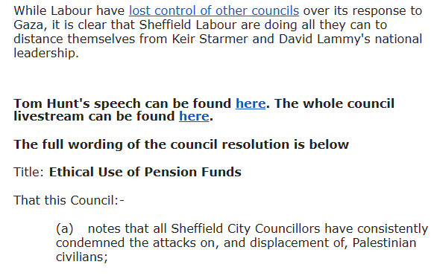
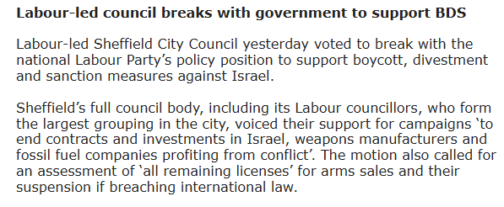

Slide 22
Challenges
Responsible Investment vs Ethical Investment
Divestment vs Engagement
Pension pooling
Labour want each pool to have minimum assets of over £100bn
Investment decisions to be made by pools
Investment advice to be provided by pool
LGPS to set asset allocation and have high level strategy statement only

Slide 23
Next steps
SYPA Responsible Investment member survey (closes 10th March
SYPA petition
Council motions in Doncaster, Barnsley and Rotherham
Lobby Border to Coast pensions pool
Lobby Labour politicians (MPs)

Slide 24

Resources
Waltham Forest Divestment Guide: https://drive.google.com/file/d/1be2pTaUZIo7OWxmzQzwRSL1OIfrcAU5J/view?usp=drive_link
Greens 4 Palestine: Advice from Cllrs & activists
Unison Toolkit: https://lgpsdivest.org/wp-content/uploads/2020/12/Unison-Pensions-Pack.pdf
PSC guide: https://lgpsdivest.org/wp-content/uploads/2024/10/The-Local-Government-Pension-Scheme-A-Campaigners-Guide-Public.pdf

